Slide 1

AN ANALYSIS ON UNIVERSITY RANKINGS
Presented By : Group 4
Course Project: MTH208 under Dr. Dootika Vats

Slide 2
What is our project about?
University Rankings’ parameters analysis and how do they vary with different parameters of their parent countries
How was the data obtained?
We obtained QS Rankings 2025 data of various top universities all around the world from
www.topuniversities.com
Data of female student ratio in various universities was scraped from www.timeshighereducation.com
Data regarding GDP, Population and GDP per capita was obtained from www.wordlometers.info
We obtained data from various sources:

Slide 3
What questions can we ask from the data?
How do the ranking parameters vary with each other among different universities?
What is the representation of various countries and regions in the top universities of the world?
How does average ranking of a country’s universities compare with its GDP per capita?
How is the quality of the universities of a country impacted by its population?

Slide 4
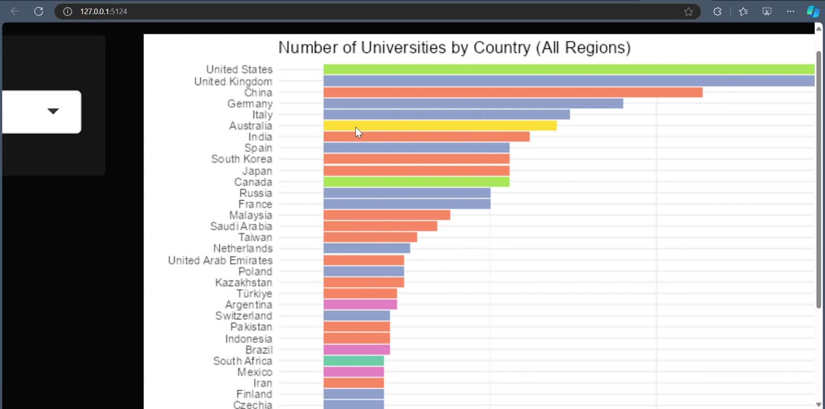
Shiny App Demonstration

Slide 5
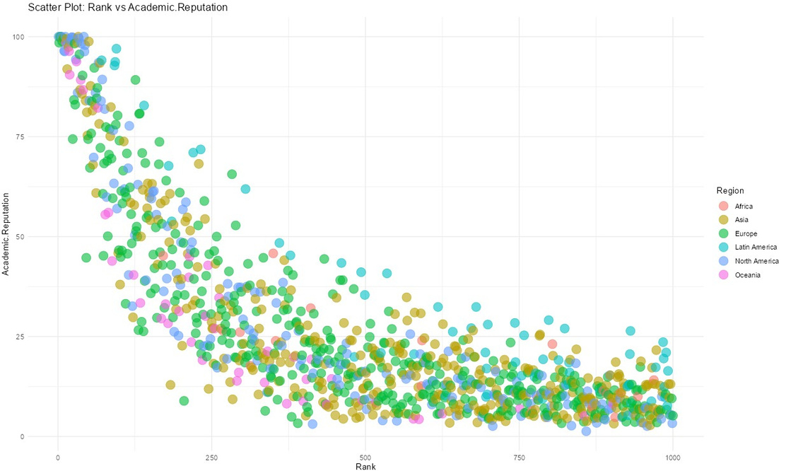
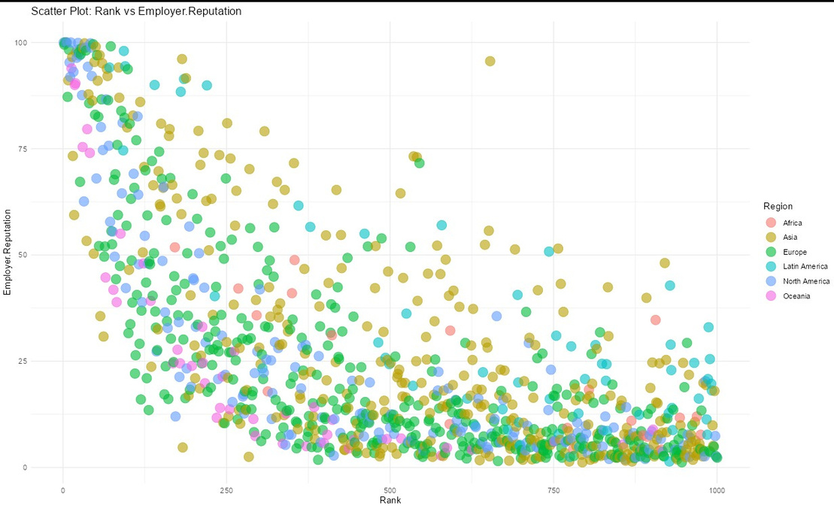
Scatter Plot of Rankings vs Academic Reputation , Employer Reputation

